Slide 1
Discrete Distributions

Slide 2
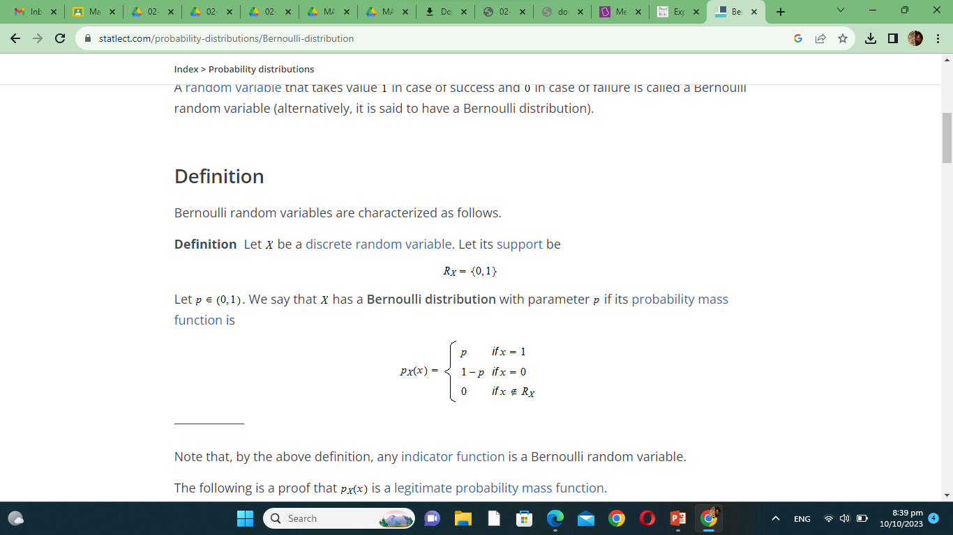
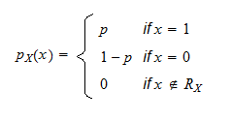
Bernoulli Distribution
Let X be a discrete random variable. Let its support be
X has a Bernoulli distribution with parameter p if its probability mass function is:

Slide 3
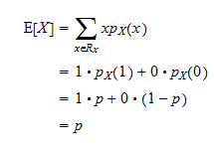
Mean of Bernoulli Distribution
The expected value of a Bernoulli random variable X is

Slide 4
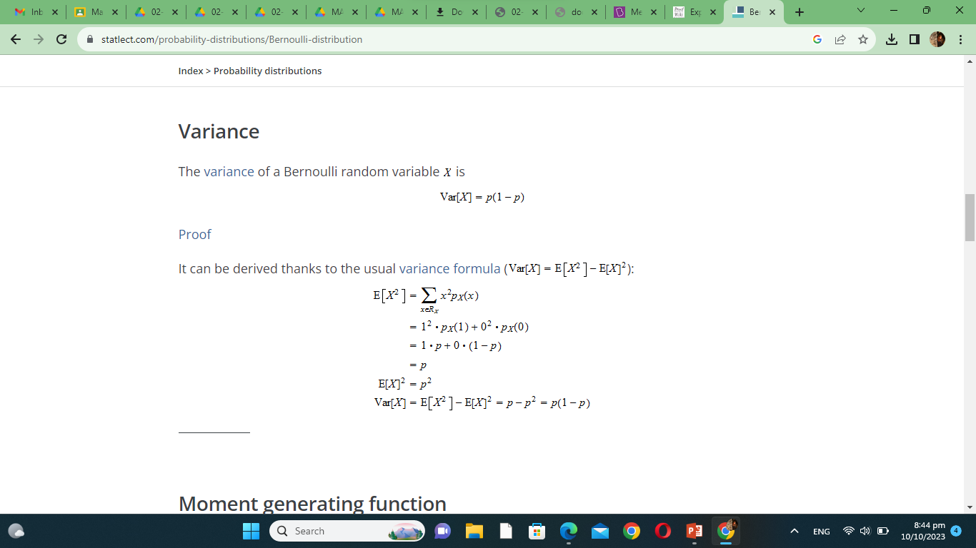
Variance of Bernoulli Distribution
The variance of a Bernoulli random variable X is

Slide 5
Bernoulli Distribution
A Bernoulli Distribution has
  Mean = p
  Variance = p(1-p)

Slide 6
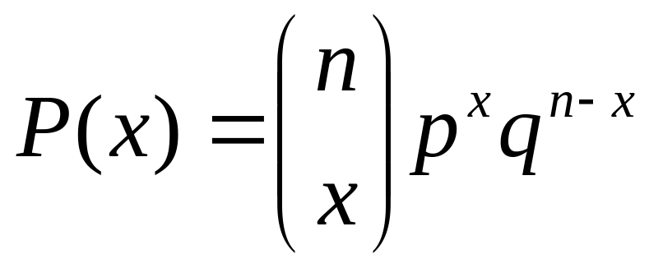
Binomial Distribution
A Bernoulli trial can result in a success with probability p and a failure with probability q = 1−p. Then the probability distribution of the binomial random variable X, the number of successes in n independent trials, is
  p = Success
  q = Failures(1 – p)
  n = number of trials
  x = number of successes

Slide 7
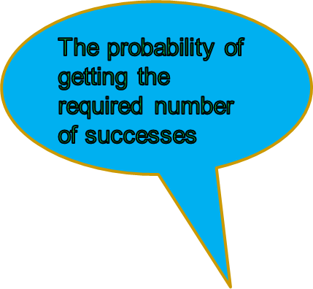
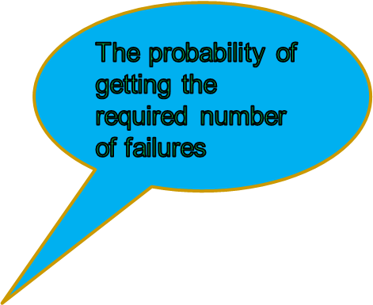

Binomial Distribution
The Binomial Probability Distribution

Slide 8
Properties of Binomial Distribution
The Binomial distribution must possess the following properties:
The experiment consists of repeated trials.
Each trial results in an outcome that may be classified as a success or a failure.
The probability of success, denoted by p, remains constant from trial to trial.
The repeated trials are independent.

Slide 9
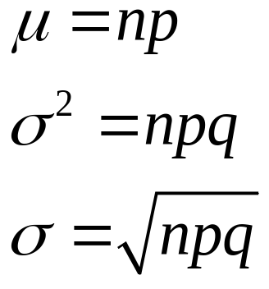
Binomial Distribution
A Binomial distribution has
  Mean
  Variance
  Standard Deviation

Slide 10
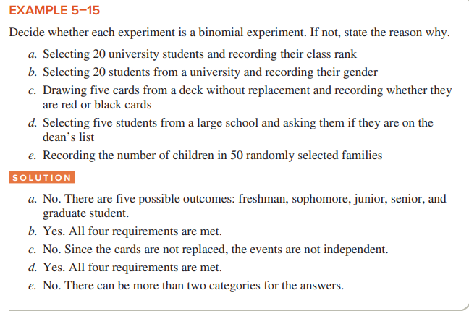

Slide 11
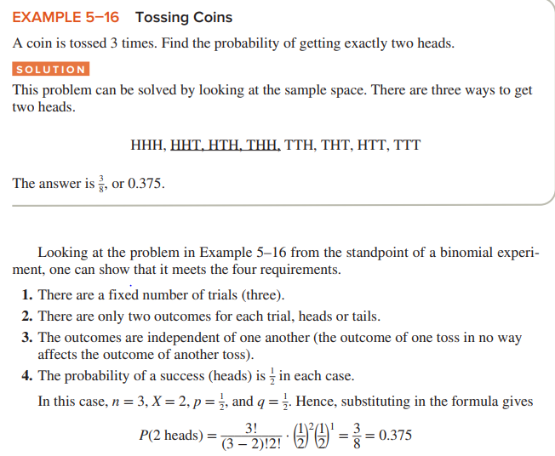
Binomial Distribution

Slide 12
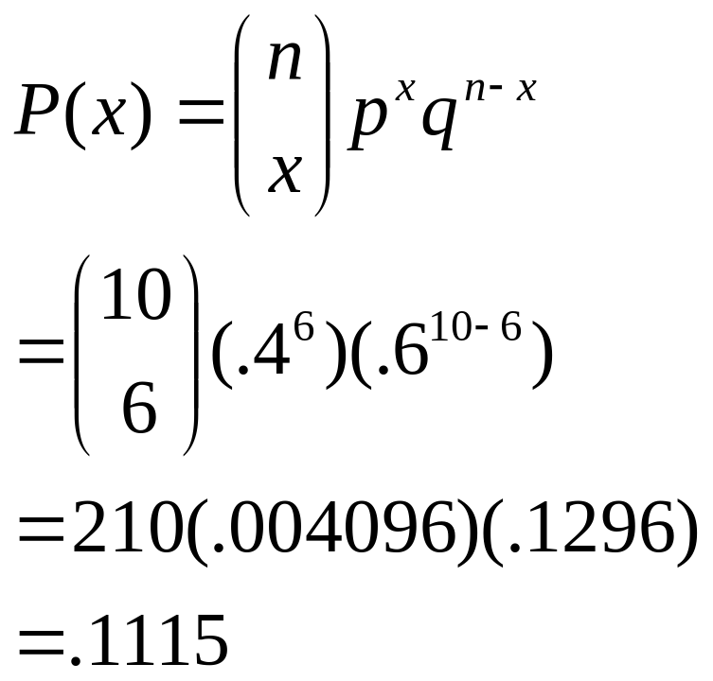
Example
Say 40% of the class is female.
What is the probability that 6 of the first 10 students walking in will be female?

Slide 13
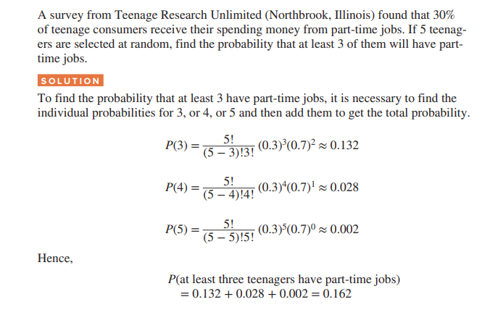
Example

Slide 14
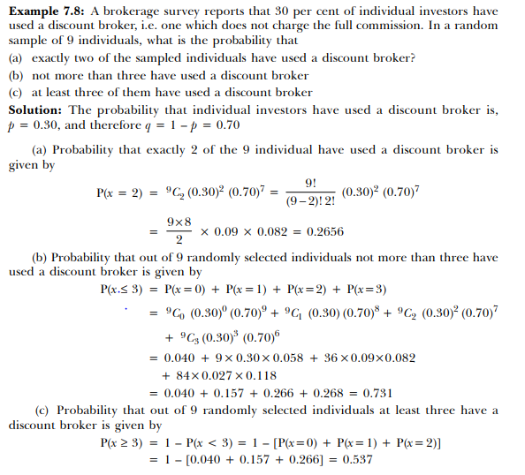

Example

Slide 15
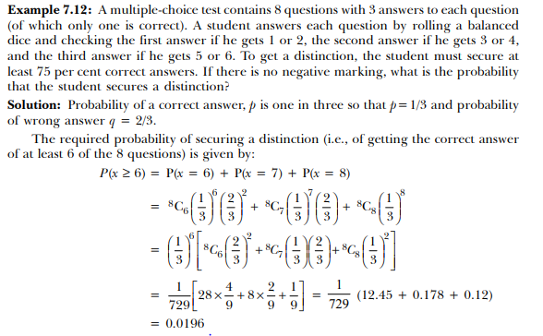

Slide 16
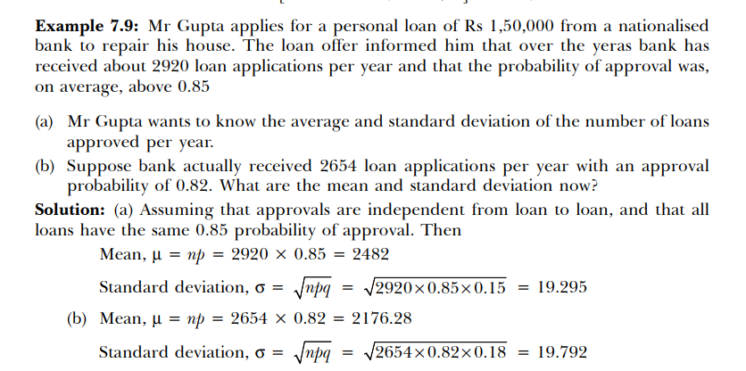
Example

Slide 17
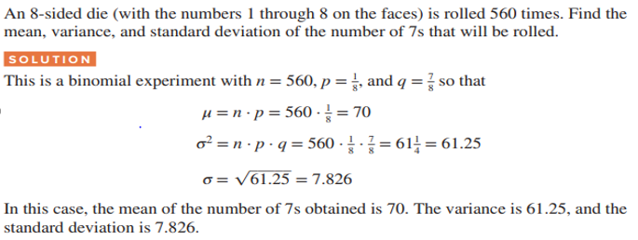
Example

Slide 18

Geometric Distribution
If repeated independent trials can result in a success with probability p and a failure with probability q = 1 − p, then the probability distribution of the random variable X, the number of the trial on which the first success occurs, is

Slide 19
Properties of Geometric Distribution
A geometric experiment is a probability experiment if it satisfies the following requirements:
Each trial has two outcomes that can be either success or failure.
The outcomes are independent of each other.
The probability of a success is the same for each trial.
The experiment continues until a success is obtained.

Slide 20

Geometric Distribution
The expectation and variance of Geometric distribution,
E(X) = 1/p
Var(X) = (1 − p) / p²

Slide 21
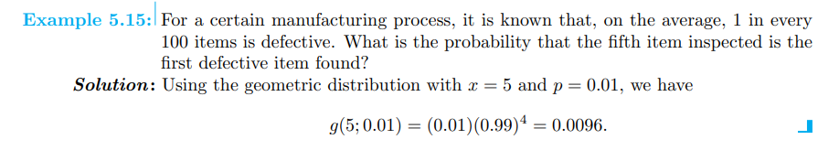
Example

Slide 22
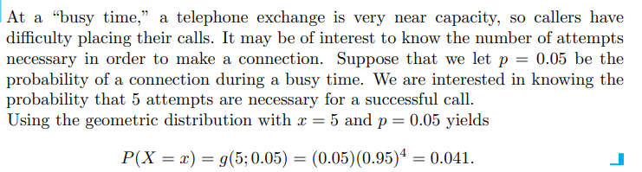
Example

Slide 23
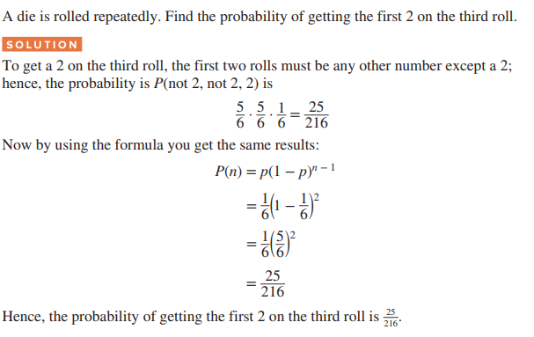
Example

Slide 24
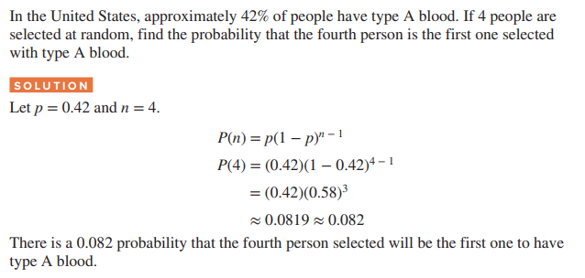
Example

Slide 25
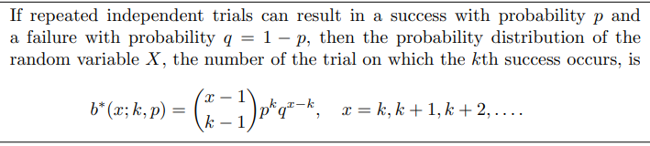
Negative Binomial Distribution

Slide 26

Negative Binomial Distribution
The expectation and variance of negative binomial distribution,
E(X) = k/p
Var(X) = k(1 − p) / p²

Slide 27
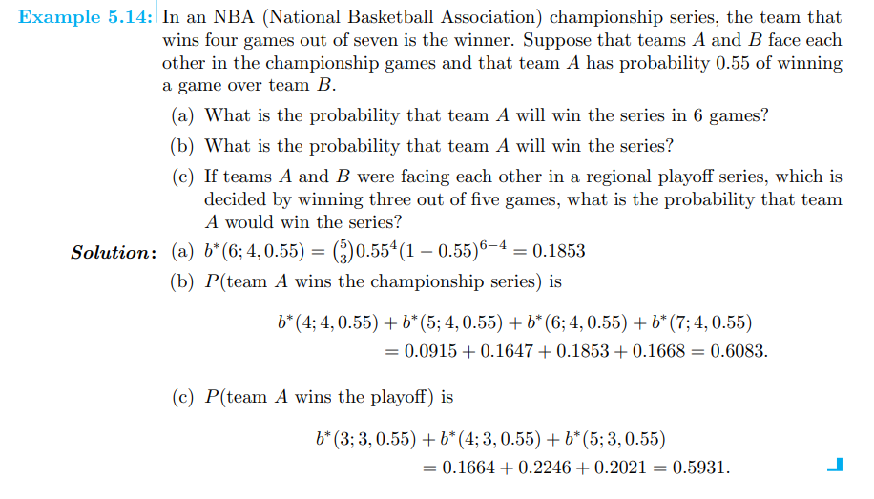
Negative Binomial Distribution

Slide 28
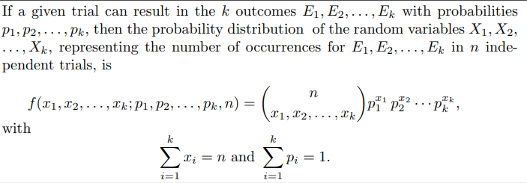

Multinomial Distribution

Slide 29
Properties of Multinomial Distribution
A multinomial experiment is a probability experiment that satisfies the following four requirements:
There must be a fixed number of trials.
Each trial has a specific but not necessarily the same number of outcomes.
The trials are independent.
The probability of a particular outcome remains the same.

Slide 30
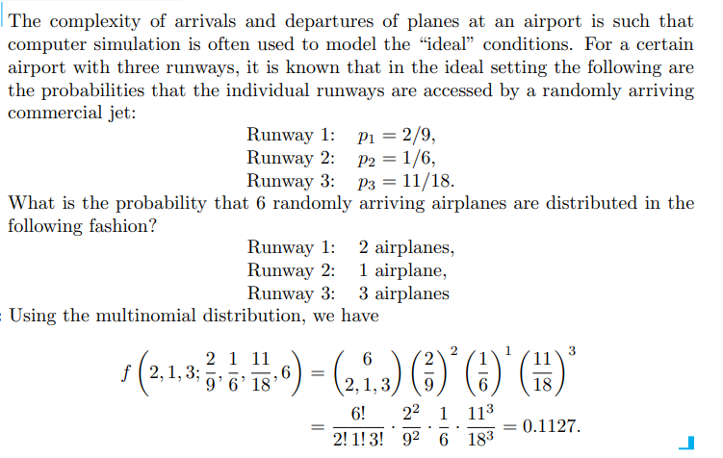
Example

Slide 31
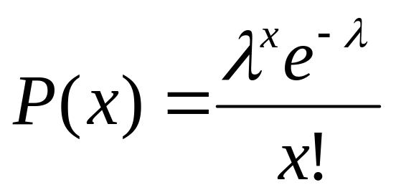

Poisson Distribution
The probability distribution of the Poisson random variable X, representing the number of outcomes occurring in a given time interval or specified region denoted by x is
● = mean number of occurrences
e = 2.71828….

Slide 32
Poisson Distribution
Evaluates the probability of a (usually small) number of occurrences out of many opportunities in a
  Period of time
  Area
  Volume
  Weight
  Distance
  Errors per page
  Other units of measurement

Slide 33
Properties of Poisson Distribution
A Poisson experiment is a probability experiment that satisfies the following requirements:
The random variable X is the number of occurrences of an event over some interval (i.e., length, area, volume, period of time, etc.).
The occurrences occur randomly.
The occurrences are independent of one another.
The average number of occurrences over an interval is known.

Slide 34
Poisson Distribution
The expectation and variance of poisson distribution,
E(X) = λt
Var(X) = λt

Slide 35
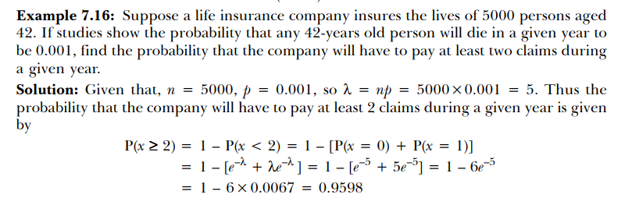
Example

Slide 36
Hypergeometric Distribution
In the binomial situation, each trial was independent.
  Drawing cards from a deck and replacing the drawn card each time.
If the card is not replaced, each trial depends on the previous trial(s).
  The hypergeometric distribution can be used in this case.

Slide 37
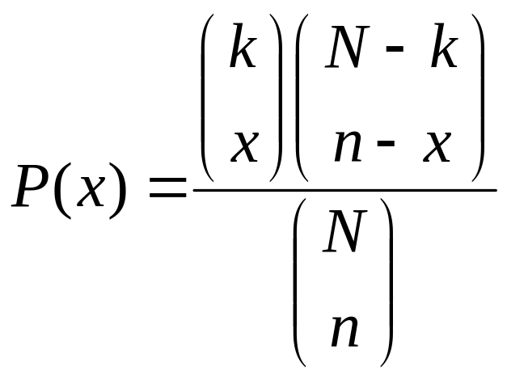
Hypergeometric Distribution
where
N = the total number of elements
k = number of successes in the N elements
n = number of elements drawn
x = the number of successes in the n elements

Slide 38
Properties of Hypergeometric Distribution
Randomly draw n elements from a set of N elements, without replacement. Assume there are k successes and N-k failures in the N elements.
The hypergeometric random variable is the number of successes, x, drawn from the k available in the n selections.

Slide 39
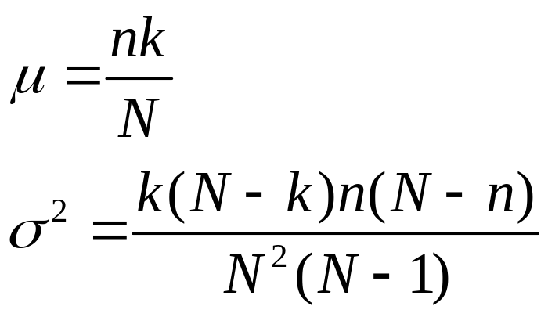
Hypergeometric Distribution
The expectation and variance of hypergeometric distribution,

Slide 40
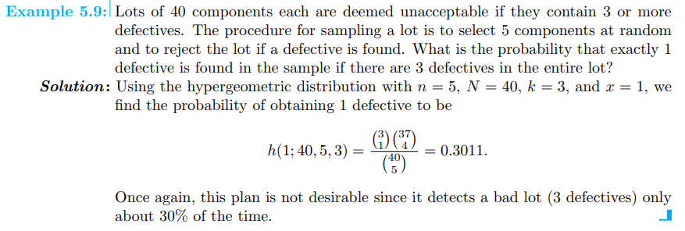
Example

Slide 41
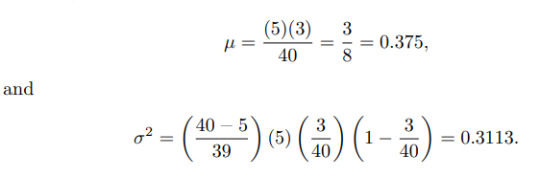
Example

